Slide 1

INTERNATIONAL CONFERENCE
THE IMPACT OF COVID 19 ON AIR TRANSPORT /
LESSONS LEARNED / PREPARING FOR THE FUTURE
  ORGANISERS: EATEO and FSF-MED
  ENAC
Cyprus, June 14 2022

Slide 2
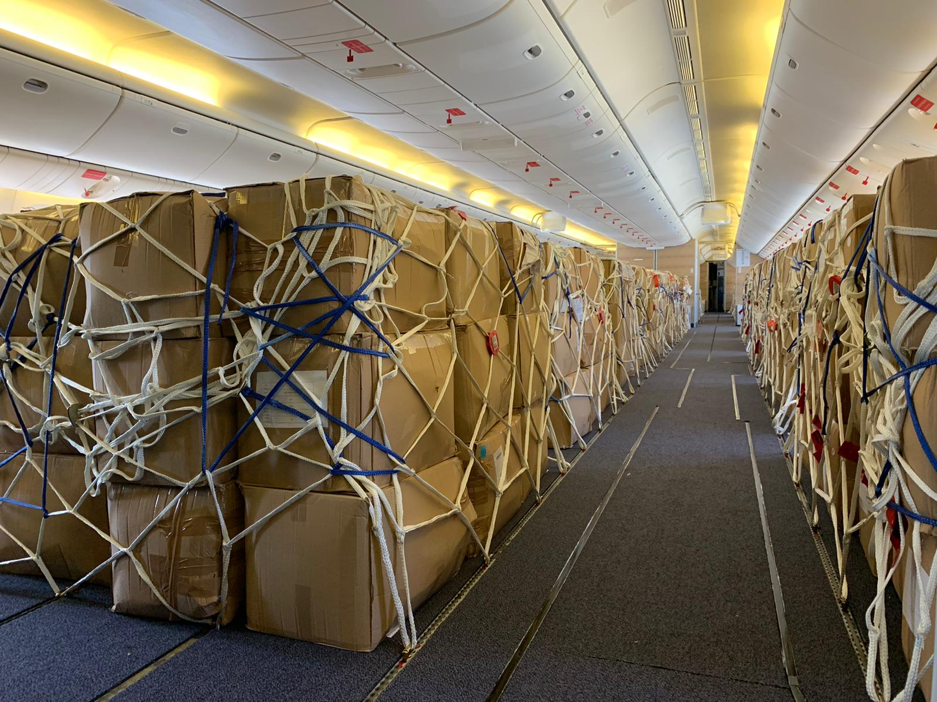
THE IMPACT OF COVID 19 ON AIR TRANSPORT
CRONOLOGY
  PHASE 1: LOCKDOWN (WINTER-SPRING 2020)
  PHASE 2: RECOVERY FROM FIRST WAVE of COVID (SUMMER 2020)
  PHASE 3: SECOND WAVE of COVID and «SELECTED LOCKDOWN» (AUTUMN 2020- WINTER 2021)
  PHASE 4: RECOVERY AFTER VACCINE CAMPAIGNS (SPRING-SUMMER 2021, and after)

Slide 3
THE IMPACT OF COVID 19 ON AIR TRANSP. PHASE 1 Economy
Impacts
Reactions
Financial losses
Increased costs and burdens
Loss of direct and indirect jobs
Economic support measures by States
Relief measures by the Authorities
Overall number of passengers
2022 vs. 2019 - 25% up to - 29%
2021 vs. 2019 - 49%
2020 vs. 2019 - 60%

Slide 4
THE IMPACT OF COVID 19 ON AIR TRANSP. PHASE 1 Activities
Impacts
Reactions
Reduction of ground activities (Airports, Factories, Workshops)
Reduction of passenger air transport: closure of 70% of airports demanded by Decree n. 112 March 2020;
Increase of Air Transport for Healthy and Humanitarian Flights
Increased request of Cargo Flights
Increased of Aerial Territorial surveillance: monitoring of unauthorized people.
Extensive cooperation with EASA for the definition of Flexibilty provisions according to art. 71 of Regulation (UE) n.2018/1139;
Issuing of Guideline for doctors and aeromedical centers for the suitability of pilots who have contracted COVID 19 (rif. Doc. 2020/001 MEDI 29/07/2020);
The Government delegated the Italian CAA ENAC for topics defined in “ICAO CAPSCA” - (Collaborative Arrangement for the Prevention and Management of Public Health Events in Civil Aviation);

Slide 5
THE IMPACT OF COVID 19 ON AIR TRANSP. PHASE 1 Authorities and Organizations
Impacts
Reactions
Staff training
Block of Aircraft maintenance access
Aircraft configuration changes and capacity reduction
Quarantine / isolation, illness and staff turnover
Use of personal protective equipment
Contingency and Safety assessment measures for COVID-19 emergency to guarantee the continuity of the services provided both by ENAC and ATM/ANS providers (ENAV);
Massive use of Informatics tools /«web connection» for audit (desktop audits)

Slide 6
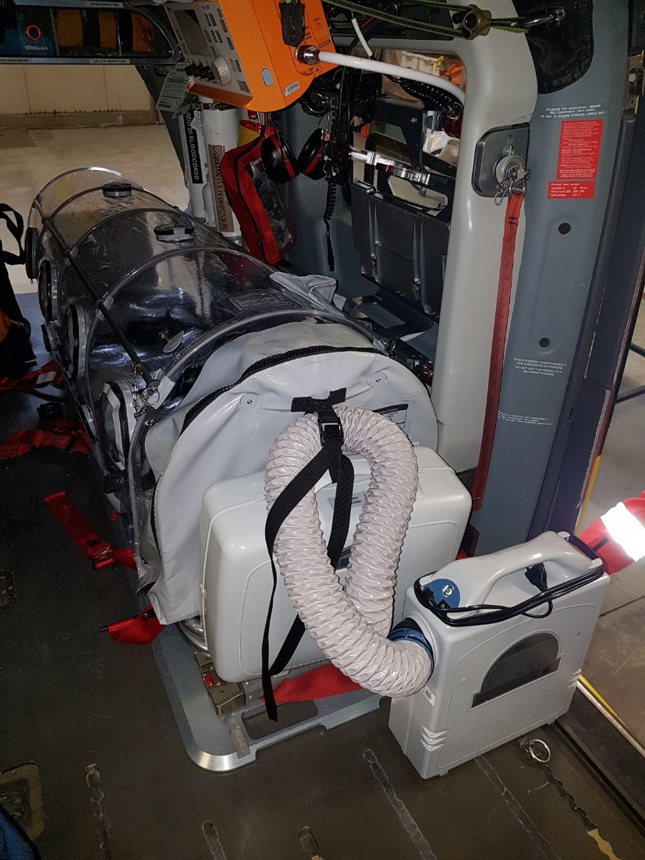
THE IMPACT OF COVID 19 ON AIR TRANSPORT
PHASE 1 – REACTIVE & OPS MANAGEMENT
HEMS/EMS operations management
  Change of cabin configuration from pax to cargo COMPARTMENT for transport of PPE and medicines
Humanitarian Flights Leonardo Experimental Helicopters (Permit to Fly):
ENAC Guidelines for the installation of the ISOARK N36. High Bio-Containment System on helicopters AW139 and AW169 Helicopters.
EASA Guidelines. Transport of cargo in passenger compartment - exemptions under article 71(1) of Regulation 2018/1139.
EASA Guidelines for the transport of COVID-19 infected patients using containment devices- exemptions under article 71(1) of the Basic Regulation.

Slide 7

THE IMPACT OF COVID 19 ON AIR TRANSPORT
PHASE 1 – REACTIVE & OPS MANAGEMENT
Extension of personnel licenses (pilots, ATCOs, LMAs)
Airworthiness Review Certificate Extension;
Territorial surveillance by means of drones.
On site audits when not deemed deferrable;
New certificates released only after verifications on site;
HOWEVER: Remote verifications by means of direct access to organizations' databases

Slide 8
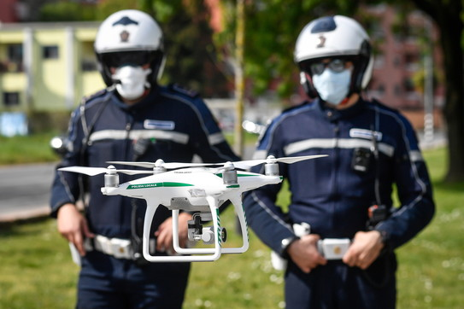
THE IMPACT OF COVID 19 ON AIR TRANSPORT
PHASE 1 – UAS use for police missions
UAS environment.. 2019/947 applicable
Sudden need to use drones in urban environment for law-enforcing (mainly lockdown decisions) pandemic containment measures
Existing regulations were not as handy as Open category missions of Reg. 2019/947, and therefore a big deal of regulatory activity was needed

Slide 9
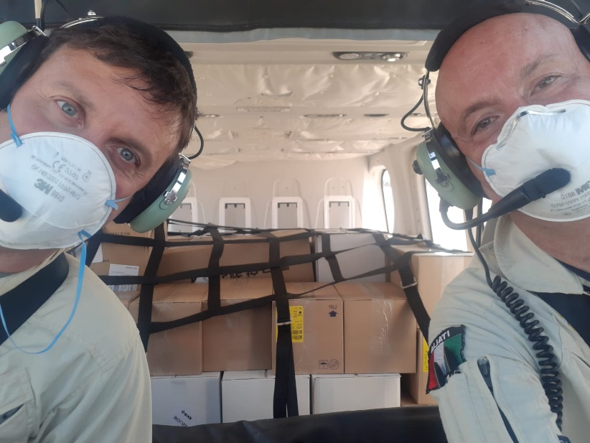
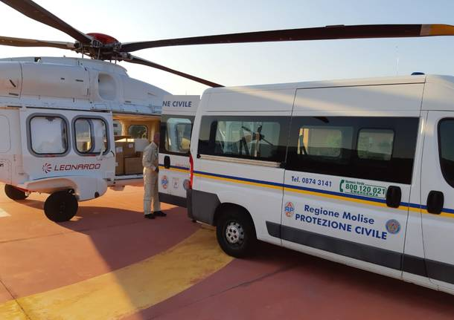
Management of Health Emergency
Flexibility provisions
In order to ensure the continuity of operations in safe conditions ENAC issued exemptions in the following Domains:
EXTENSION of the periods of Validity of LICENSES, QUALIFICATIONS, CERTIFICATES, TRAINING AND CONTROL ACTIVITIES, as demanded by EU REGULATIONS 1178/2011 AND 965/2012;
EXEMPTION form the “TWO YEARS” EXPIRATION of TRAINING for the AIR TRANSPORT of DANGEROUS GOODS;
EXTENSION of Validity periods of AIRWORTHYNESS REVIEW CERTIFICATES when the Aircraft is in a CONTROLLED ENVIRONMENT (NO GENERAL AVIATION);
EXTENSION of Validity of the OVERSIGHT PROGRAMS (AIR/OPS/ADR/FSTD);
EXTENSION of Validity periods for MEDICAL CERTIFICATES (PILOTS, AIR TRAFFIC CONTROL OPERATORS)

Slide 10
THE IMPACT OF COVID 19 ON AIR TRANSPORT
PHASE 1 – Oversight & ATM data
Exemption potentially applicable expiring oversight cycles (121 Air & OPS Organizations; 20 FSTD). Applied to 47 of them;
Calendar planned audit/inspections deferred accordingly or desktop verifications;
Desktop reviews of documents and records (e.g. Desk audit/RAP) up to end of 2020 and remote interviews of organizations' personnel (e.g. Resp. Managers Interview by means of Skype/Google Meet)
Domestic and International Traffic reduced (2020 vs 2019) by: 65 % in March, 90 % in April;
Overflying Traffic reduction by: 36 % in March, 92 % in April.

Slide 11
THE IMPACT OF COVID 19 ON AIR TRANSPORT
PHASE 2 – restart summer 2020
  Oversight activities: on site follow-ups after «remote/desktop» phase and cooperative oversight (ACAM inspections arrangment provisions);
  Gradual reopening of Airports for commercial and general aviation traffic (from June to August);
  August 2020: Overflying Traffic “increased” to 40%, in March, to 92% in April - ATCO Safety assessment updated for the Return to Normal Operations
  Cyber attacks: Government Authorities subject to Hackers Attacks (ENAC 2 weeks of systems offline);
  Shortage of maintenance spare parts.

Slide 12
THE IMPACT OF COVID 19 ON AIR TRANSPORT
PHASE 3 – SECOND WAVE
  NO new flexibility provisions to EU rules applied in this phase;
  Strengthening of PHASE 1 reactive management topics;
  Development of NAA Cooperative Oversight (e.g. ACAM Inspections)

Slide 13
THE IMPACT OF COVID 19 ON AIR TRANSPORT
PHASE 4 - LESSONS LEARNED 1/3
  Measures coordinated and harmonized at a global, regional and national level, mutually accepted
  Lightening measures that allow for temporary deviation from ICAO / EASA standards:
  they must not compromise safety;
  always reported to ICAO (CRRIC) or EASA;
  they must not be maintained beyond the crisis

Slide 14
THE IMPACT OF COVID 19 ON AIR TRANSPORT
PHASE 4 - LESSONS LEARNED 2/3
  Digitalization: development in the use of technologies/remote connection networks;
  Definition of case studies for reasonable remote audits performance;
  Strengthening of intersectoral coordination among Civil Aviation Authorities (cooperative oversight) or Facilitation Committee
  Development of Performance & Risk Based Oversight;

Slide 15
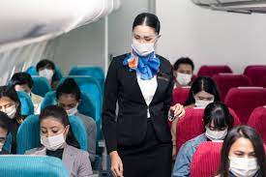
THE IMPACT OF COVID 19 ON AIR TRANSPORT
PHASE 4 - LESSONS LEARNED 3/3
  Standard Guidelines for use of electronic signature;
  Development of Cyber Security with cooperation among NAAs;
  Rapid increase of monitoring the “mitigations” introduced in practice by the organisation’s management system after the COVID;
  Development of unmanned operations

Slide 16
THANK YOU for YOUR ATTENTION

